Slide 1
The Importance of Visual Trends
Oscar Gines

Slide 2
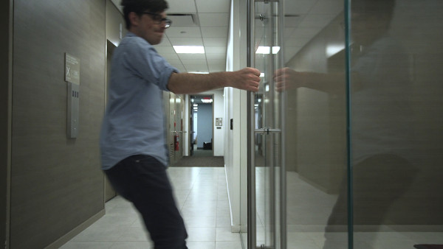
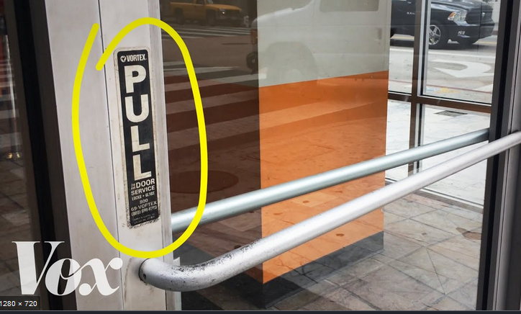
Have you ever…
Notes:
Have you ever pulled on a door handle
that looks like it was intended to be pulled,
when in fact it was a push door?
It’s clear that if the visual language is well thought out,
the desired actions are natural and go without saying
it’s safe to say that design can influence products
in a negative way if there isn’t a method to the madness
My intent today is to help us identify the approaches
needed to give credence when working with customers
who are unfamiliar with our backgrounds
and philosophies as visual communicators
To further empower our base
And to stay steadfast in our graphic approaches and expertise.

Slide 3
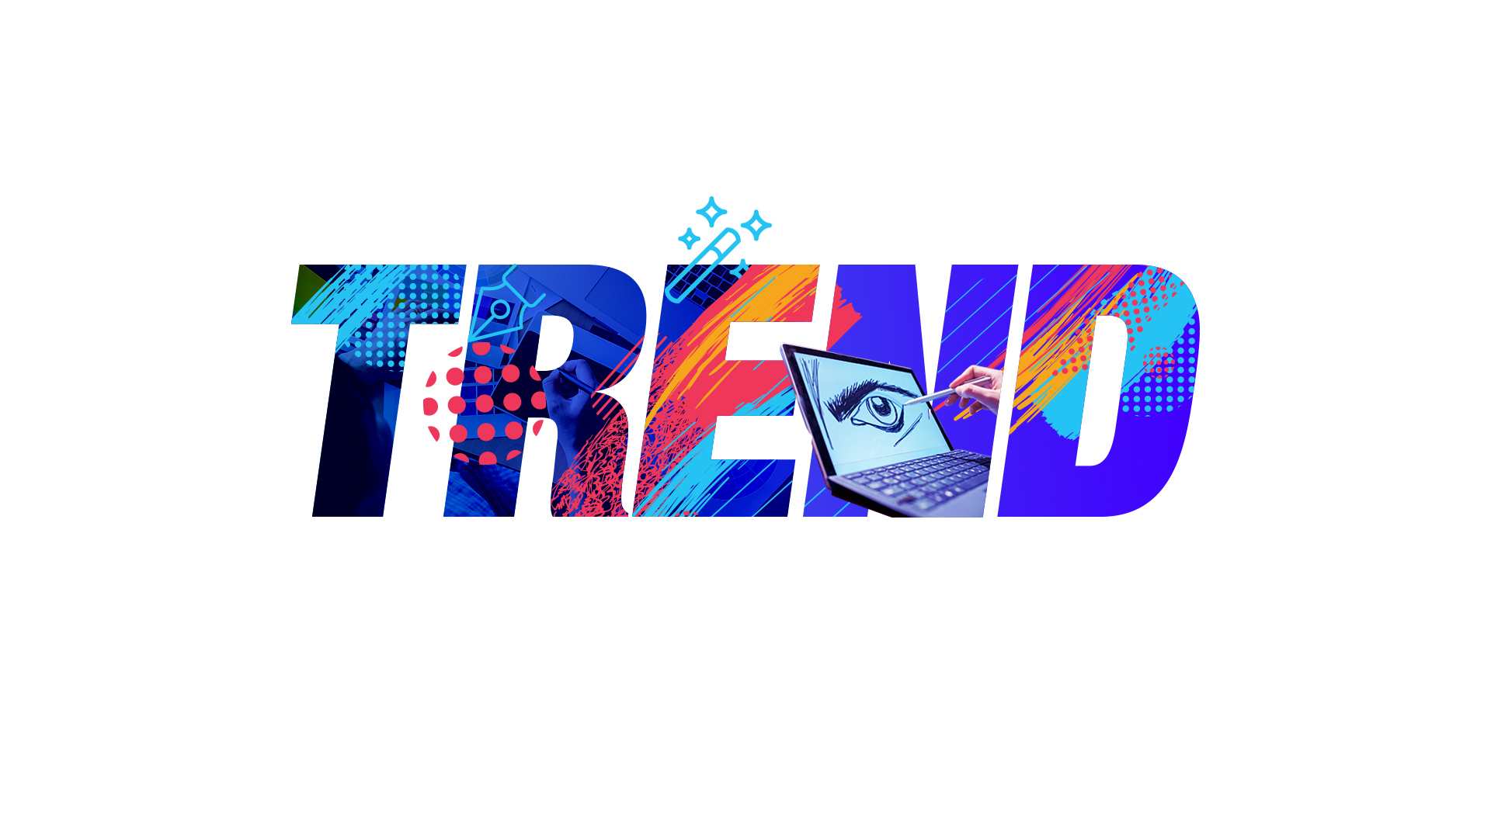
About visual trends; what they even are and why it’s important to keep up.
Notes:
Specifically ,
about the Importance of evolving our methods
and approaches to stay relevant with current visual trends.
I feel this is especially important as we may be working with clients
who have served this corporation loyally
possibly for several decades, and maybe these clients
have become resistant to change.
We should be empowered to push back at times
when this is the case and a stakeholder requests a deliverable
In a style that is not inline with current visual trends
And has long passed it’s “sell by” date
Also to promote collaboration and understanding
with the customer. So an argument can be reframed as
an opportunity for education through a non-challenging approach.
I’d like us as a team be able to speak confidently to our clients about why visual trends are important.
And when you should go against the grain,
push back and advocate for a better and more engaging product.

Slide 4

Notes:
Now If you were browsing on a site like Google in the 90s,
you would encounter a visual language like this.

Slide 5
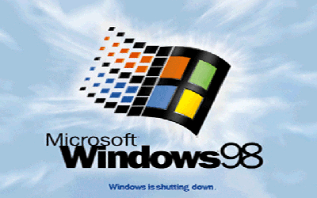
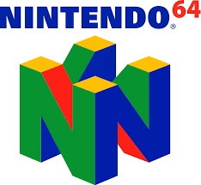


Notes:
In the 90s the visual trend was focused on 3D imagery
An important caveat to mention is the fact
that many successful companies alter their logos frequently
in an effort to be perceived as contemporary and relevant
like in case of Pepsi and their brand.
Also, that this will not be a bash
on design trends of the past.

Slide 6

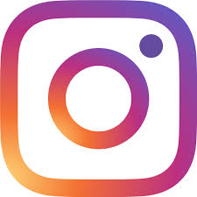

Notes:
If you jump online today, you will find visual language like this.
So, what is the common stylistic choice with these logos?
They’re all 2-dimensional.
The intent in using this style is that these flat visual assets enable brands
to format their mark on a wide variety of media.
These marks are succinct and offer a tidiness
which allows it to pair well with a multitude of formats
which include video, web and print media
Graphic designers also benefit, because when tasked with
communicating the brand through deliverables,
they can do so without any development hang ups
related to tools and settings

Slide 7
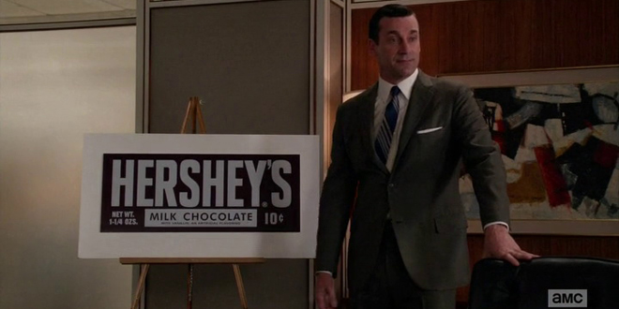


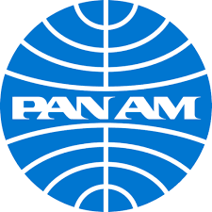
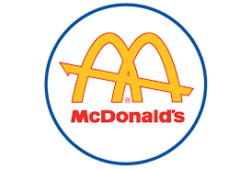
Notes:
If you were a fan of the show Madmen like I was.
You’re likely familiar with the style of the 60s.
The style of this time was quite unique.
Commercial artist of this time were focused on the visceral reactions of their work.
They really understood the benefits of creating a succinct icons to represent their product
They weren’t into overly complicating something that ideally should be absorbed in mere seconds.
This era was a milestone time in commercial art
and you will notice that many of the brands
also featured a 2-dimensional visual language.

Slide 8
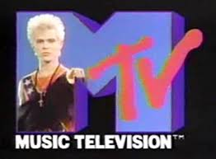
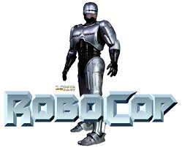
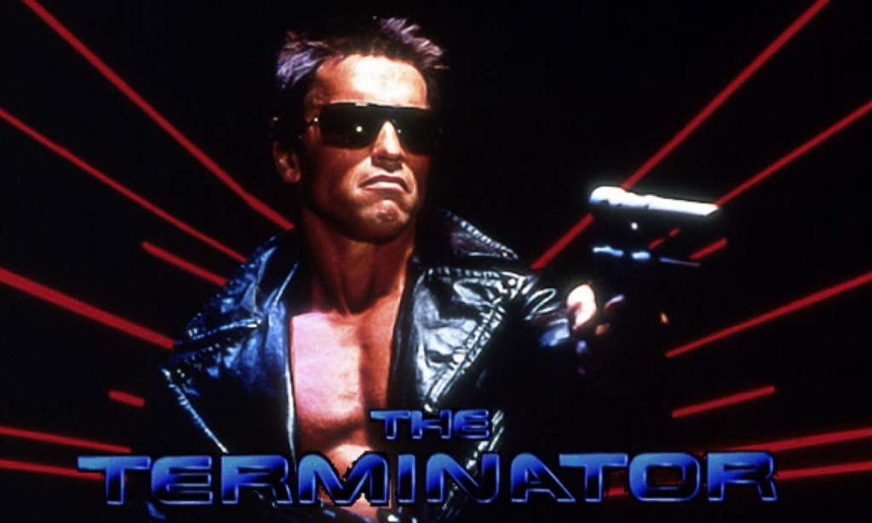
Notes:
In the 80s the style shifted to a more 3D look.
This due in large part to the enhanced capacity for CGI.
It was the new shiny toy,
and it’s important to remember that like with cars
and Fashion.
Style is often very cyclical.

Slide 9
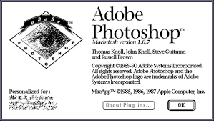
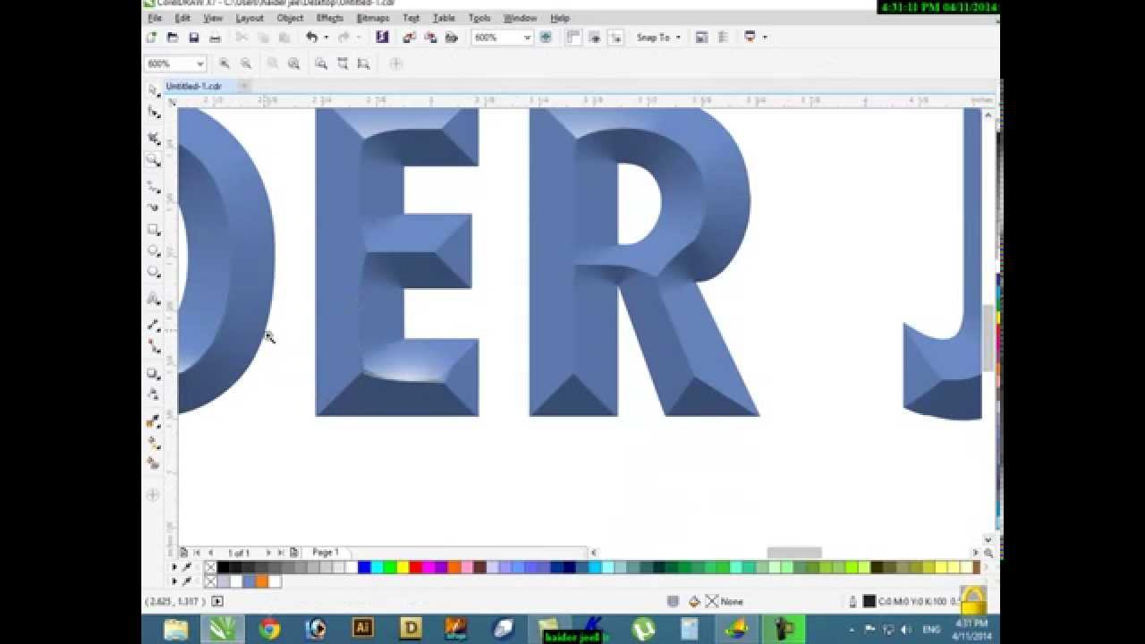

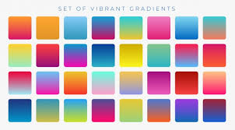
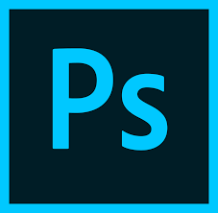
Notes:
In the beginning of the 21st century
we got the rise of Photoshop and other Adobe products.
With these tools it became simple to produce bevels,
gradations of color and other modern style queues.
Because of this, web design language evolved in tandem
and it seemed as if every website at the time had a shiny buttons.
You can see this in full effect
in another cornerstone
design product of the time,

Slide 10
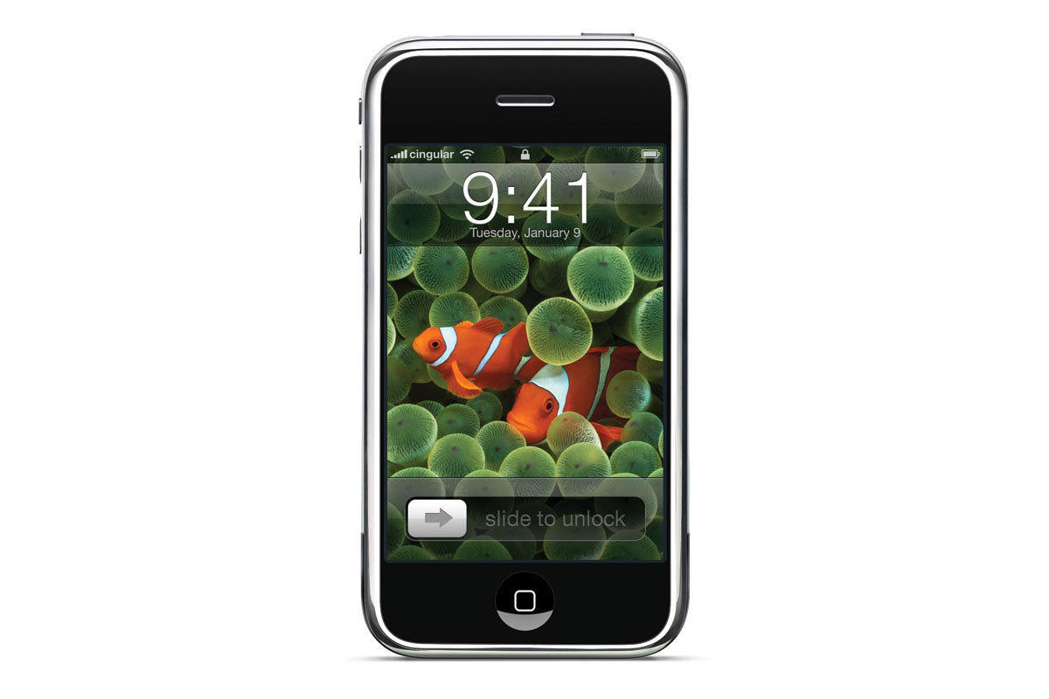
Notes:
The original iPhone.
This style of emulating buttons and gradations of real world objects
is referred to as skeuomorphism.
This style was especially important at the time
as people were not used to using touch screens.
The iPhone had virtually no buttons
and if you didn’t know what to press
then the product would obviously fail.
The intent for apple was to make the masses comfortable
with pressing the simulated buttons.
To make the experience as natural as possible.

Slide 11
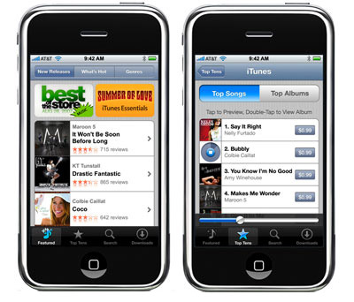
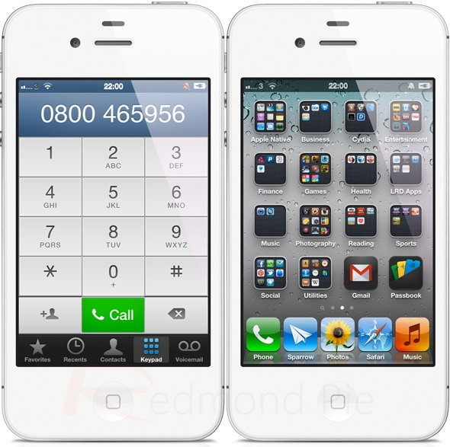
Notes:
As time passed
and more and more of the user base
was comfortable with using touch screens.
Apple was free to deal with the down side of skeuomorphism.
That was the fact that these skeuomorphic styles
were heavy in visual weight, this style offers little in marking clear delineations of content areas and
often felt very visually cluttered
Additionally, recreating this style
can become a challenge if the designers tasked to recreate the look
Aren't explicitly communicated exactly what design tool
or settings were used to create the look.
This style also does not scale well to large formats
As they will inevitable suffer from pixilation

Slide 12
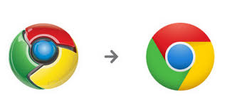
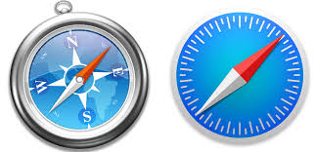
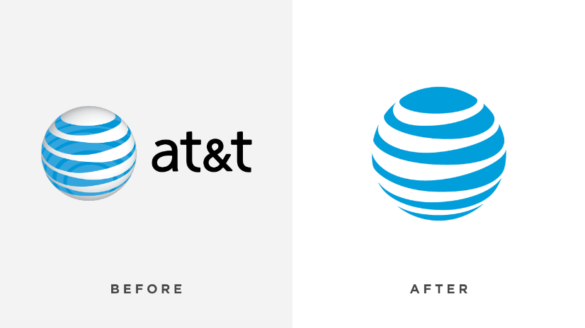
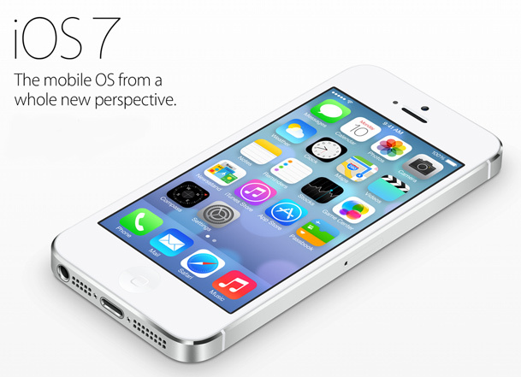
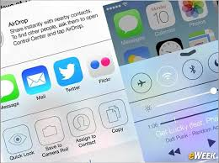
Notes:
So in 2013,
apple shifted away from this visual language overnight and adopted the flat UI
This gave websites a sense of cleanliness and ease of use.
The visual elements of pages in this style were allowed to quote breathe.
And as expected,
all of the brands that had a web or app presence
quickly followed suit to match the visual language

Slide 13
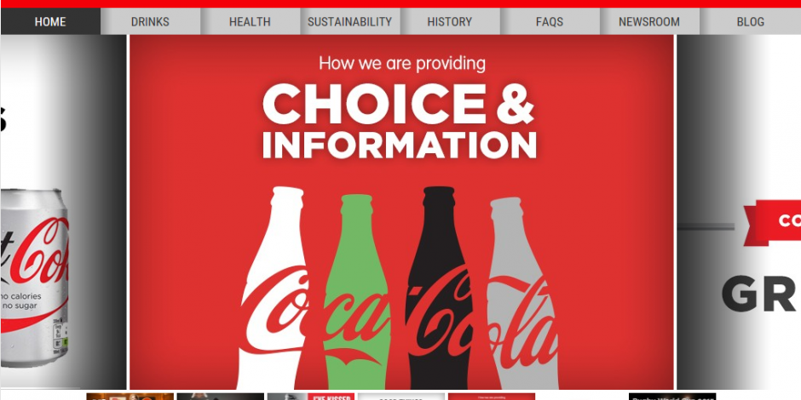
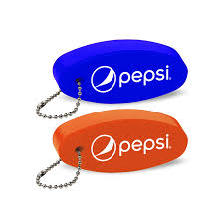
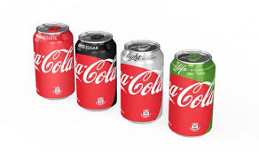
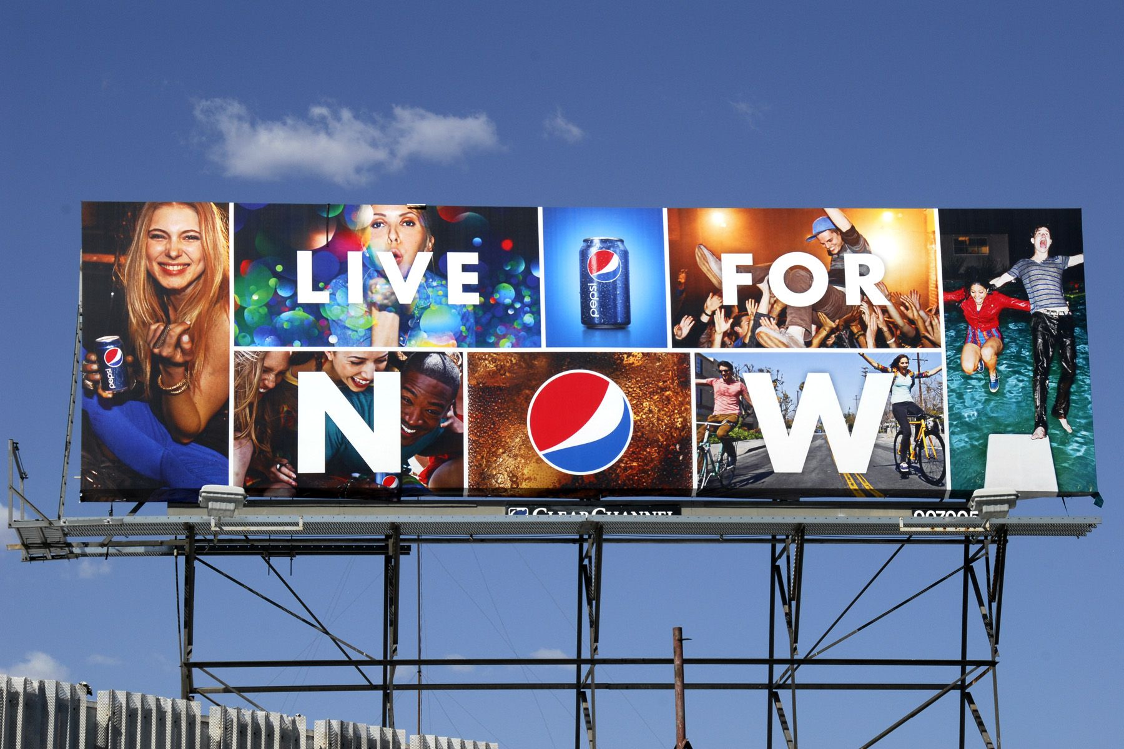

Notes:
Additionally, the flat ui trend was adopted heavily
as not only a stylistic choice
but an informed choice of sustainability.
With the flat UI, graphic designers could replicate modern visual styles
with relative ease and because these styles favored vector graphics.
The styles could be replicated to scale
and on far more media than previously possible.

Slide 14
#WeCanDoBetter!
Scratch that…
#WeShouldAlwaysDoBetter
https://www.nngroup.com/articles/flat-design/
https://medium.com/@cadabrastudio/5-books-on-the-history-and-theory-of-graphic-design-3079e9dfb837
https://www.amazon.com/Meggs-History-Graphic-Design-Philip/dp/0470168730
Notes:
As visual communicators we should strive to know the history of design
so that we can speak to decisions over time;
We should know how to articulate why modern design is not only aesthetic
or trendy but why it is grounded in and
how they are used on different technical platforms
or how they evolved in response to cultural
perceptions and needs
We should be able to reframe disagreements with clients
to start a conversation and promote collaboration and education

